Slide 1
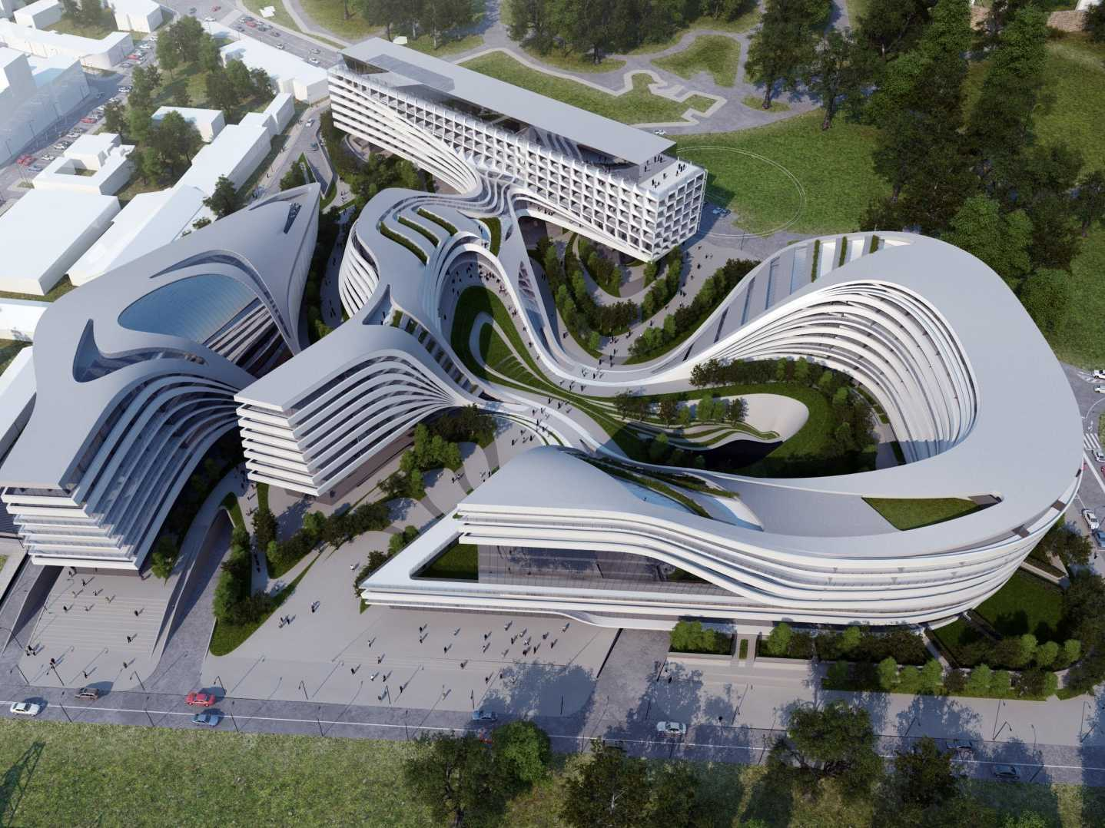
Data Virtualization
Data Abstraction Best Practices Overview
Presenter
Title

Slide 2
Agenda
Data Abstraction Reference Architecture
Feature 3: Privilege Framework
Feature 4: Annotations Framework
Feature 1: View Generation Framework
Feature 2: Dynamic File Framework
Notes:
We will begin with an overview of view creation. Next, we’ll take a detailed look at all of the tabs on the View Editor window. Then we’ll look at two different, but complementary ways to create and edit views: drag-and-drop modeling, and direct SQL editing. We will then study execution of views. Then we will learn how to identify resources that make up complex views. We finish by looking at Model Regeneration, and Client Metadata, and then proceed to our Lab activity.

Slide 3




Data Abstraction Goals Achieve Reusability, Maintainability, and Performance
Customer Challenges
Want to build a virtualized abstraction layer for applications to access instead of accessing the physical sources
Developers code similar logic many times, so partitioning is desired
Layered approach is better, but layers can have performance overhead
Data Virtualization Solution
Decoupling and reuse sources via layered data virtualization implementation
Optimize away middle layers at runtime for better performance
Business Impact
Right information, when needed
More aligned business and IT model for better agility, efficiency, reuse
Business and IT change insulation
Better data security and control
Cost Savings
Sales Growth
Risk Reduction
Complexity
Structure
Data Abstraction
Location
Completeness
Latency
© Copyright 2000-2017 TIBCO Software Inc.
Notes:
The “Architectural Concepts” outlined in this diagram speak to 4 layers of views. Each view will be described in more detail in subsequent slides.
The main theme to understand here is that the “Canonical Views” are the key to the abstraction layer. An abstraction layer in general is put in place so that applications may access this central data authority instead of going directly to the data sources themselves. Tibco Data Virtualization provides the mechanisms to publish Data Services through Web Services or JDBC sources.
There are many good reasons to have a data abstraction layer such as the following:
Right information at the right time – Fulfill business’s complete information needs on demand by linking multiple, diverse data sources together for delivery in real-time.
Business and IT model alignment – Gain agility, efficiency, and reuse across applications via an enterprise information model or logical business model. Often times, known as the “Canonical” model, this abstracted approach overcomes data complexity, structure, and location issues.
Business and IT change insulation – Insulate consuming applications from changes in the source and vice versa. Developers create their applications based on a more stable view of the data. Allow ongoing changes and relocation of physical data sources without impacting consumers.
End-to-end control – Use a single platform to design, develop, manage and monitor data access and delivery processes across multiple sources and consumers.
More secure data– Consistently apply data security rules across all data sources and consumers via a unified security methods and controls.

Slide 4

Data Abstraction Reference Architecture Layered Architecture View
ESB/ BPM
Data Consumers
BI Server
App Server
Application Layer
Consumer
Customer
Order
Buyer
Order
Customer
Order
Business Layer
Physical Layer
customers
purchase
orders
orders
orderdetails
products
Data Sources
Customers DB
Purchasing DB
Orders DB
Product
Catalog
© Copyright 2000-2017 TIBCO Software Inc.
Notes:
Data Consumers – Client applications want to retrieve data in various formats and protocols. They want to receive the data in a way that they understand. Data Virtualization allows the consumers to format the data according to their specifications and deliver over various transport protocols including: Web Services, REST, JDBC and Java clients.
Application Layer – The “Application Layer” serves to map the Business Layer into the format which each Data Consumer wants to see their data. It might mean formatting into XML for Web services or creating views with different alias names that match the way the consumers are used to seeing their data.
Business Layer – The “Business Layer” is predicated on the idea that the business has a standard or canonical way to describing key business entities such as customers and products. In the financial industry, one often accesses information according to financial instruments and issuers amongst many other entities. Typically, a data modeler would work with business experts and data providers to define a set of “logical” or “canonical” views that represent these business entities. These views are reusable components that can and should be used across business lines by multiple consumers.
Physical Layer – The Physical Layer provides two valuable capabilities for introspecting and mapping to the Business Layer.
The physical “Metadata” sub-layer is essentially imported from the physical data sources and used as way to onboard the metadata required by the data abstraction layer to perform its mapping functions. As an “as-is” layer, entity names and attributes are never changed in this layer.
Ultimately, physical data sources have to be integrated into this virtualization layer. This is done in the “Formatting” sub-layer along with simple tasks such as name aliasing, value formatting, data type casting, derived columns and light data quality mapping. In general this layer is derived from the physical sources and performs a one-to-one mapping between the physical source attributes and their corresponding “logical/canonical” attribute name. Naming conventions are very important and introduced in this layer.
Data Sources –The data sources are the physical information assets that exist within and without an organization. These assets may be databases, packaged applications such as SAP, Web services, Excel spreadsheets and more.

Slide 5
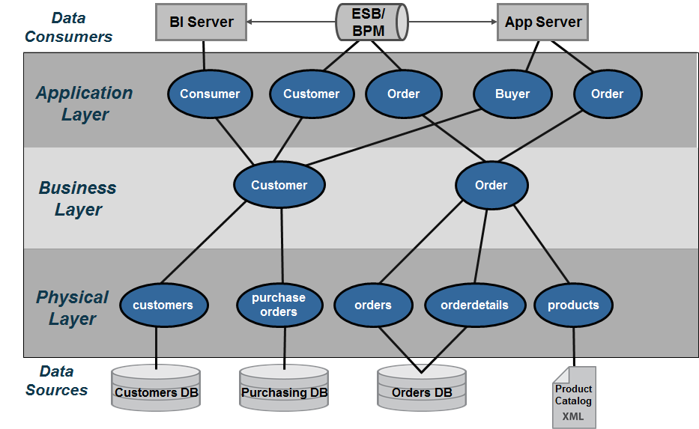
User Roles and Responsibilities
Application Developers
Developers
Enterprise
Data
Modelers
Data Governance Team
Database Administrators &
Data Modelers
© Copyright 2000-2017 TIBCO Software Inc.
Notes:
The following roles and responsibilities should be considered when implementing a data abstraction layer:
Database Administrators (DBAs) and Database Modelers – DBAs and database modelers provide access to the physical data sources. Further they help define logical database designs from their corresponding physical database designs and implementations. They work with Data Virtualization developers to ensure are properly tuned and assist with creating indexes if necessary.
Application Developers – Application developers are concerned with the API’s and the various mechanisms by which they can access the data from the data abstraction layer. Often times, data lineage is important to the client-side developers because they need to know the originating source. Data Virtualization can provide data lineage from the client services views down to the physical metadata.
Data Governance Teams – Data governance staff are involved throughout the process making sure that enterprise data access and data mapping rules are followed. Further, they provide guidance on how data should be modeled and often help to resolve data quality issues.
Enterprise Data Modelers and Data Architects – Enterprise data modelers and data architects work with subject mater experts who know the business and use their expertise to craft logical data models. These logical data models can be further refined into something that is closer to a logical database design which could be used as the basis for building views in the business layer. Enterprise data modelers work with Data Virtualization developers to design effective views and services.
Data Virtualization Developers – Data Virtualization developers are responsible for the implementation of the layers using the data virtualization middleware. This implementation is based on the overall architecture and concepts laid forth in this document and performed in conjunction with the other teams involved. They need to understand the application developer requirements so they can construct the API layers and views above the business layer as well as the underlying sources. Beyond lineage tools and folders available within Data Virtualization, these developers often use additional control systems to understand and manage key mappings across the various layers.

Slide 6
Summary of Key Benefits
Easier to build
Onboard new data sources faster
Project teams incrementally create data virtualization layer
Easier to maintain
A place for everything, and everything in its place
Isolates changes in underlying sources
Single management console for data
Administer access to data
Monitor access to data
Secure access to data
Better performance
Optimize queries across federated sources
© Copyright 2000-2017 TIBCO Software Inc.
Notes:
SUMMARY OF KEY BENEFITS
• Easier to build. Onboard new data sources faster. Project teams can incrementally create the data abstraction layer over time and realize the reusability of existing data services.
• Easier to maintain. The Tibco Data Virtualization provides a place and categorization for everything which in turn allows you to be more effective at maintaining everything in its place.
• Single management console. The Tibco Data Virtualization provides for a single management console for access to data which includes administration, monitoring and security.
• Better performance. Data Virtualization provides better performance and scalability through query optimization, caching and clustering.

Slide 7
Feature 1: View Generation Framework

Slide 8
View Generation Framework
Generate/create 1 or more views from one layer to another layer
Generate formatting layer views using a data dictionary
Alias: physical metadata USER_NAME becomes UserName
Transformations using CASE statements.
Cast types using CAST statements
Add new columns such as sysSourceType, sysTimestamp
Spreadsheet or database table driven
Generate a list of views/columns from a given folder structure recursively
Generate project folder with scripts according to best practices layers
Configure data sources into the framework
Generate documentation
Rebind resources

Slide 9
View Generation APIs
generateViews – a generic API to generate a view from source to target. The following are specialized versions:
generateFormattingViews – generate “/Formatting” views.
generateLogicalViews – generate “/Business/Logical” views.
generateBusinessViews – generate “/Business/Business” views.
generateClientViews – generate “/Application/Views” views.
generateClientPublished – generate “/Application/Published” views.
generatePublishedResource – generate the published resource.
generatePhysicalViews – generate “/Physical/Physical” layer views.
generateCastViews – generate views with CAST statements.

Slide 10
View Generation APIs
generateDatasourceList – a generic API to list the resources and columns for a given source path.
generateDatasourceListCSV – output a list of resources and columns to a file
generateDatasourceListDB – output to a database table
generateCRUDOperations – generate insert/update/delete procedures for perform “CRUD” operations
generateTypeDefinitions – generate a type definitions procedure

Slide 11
Feature 2: Dynamic File Framework

Slide 12
Dynamic File Framework
Auto-publish files from file system to DV published database folder
Auto-delete files by removing them from the file system
Invoke API via JDBC or Web Services
Automatically sends email when one of the API actions are invoked.
Ability to configure file framework at the project level in order to apply permissions on folders.
Logs activity in a database table.

Slide 13
Dynamic File Framework APIs
Invoke API via JDBC or Web Services
dynamicFileList – list the file, metadata, and published resources.
dynamicFileCreate – register a file to be created within the framework.
dynamicFileRemove – register a file to be removed from the framework. Removes file and all views in all layers.
dynamicFileCleanup – register an action to perform a clean-up on CSV and Excel files.
dynamicFileRebuild – rebuild a broken file/view lineage.
dynamicFileAutoPublish – automatically register any files in the file system that have not been added to TDV.
emailAddUser / emailAddUserList – add a user/users list of emails to the “DYNAMIC_FILE_EMAIL” database table.

Slide 14
Dynamic File Framework Triggers
Central Dynamic File Processing Trigger
DynamicFileFrameworkProcessTrigger – Processes all requests that are registered into the database table “DYNAMIC_FILE_QUEUE”.
Project-level Triggers
DynamicFileFrameworkAutoPublishTrigger – A timer-based trigger that periodically checks the configured file system for new files.
DynamicFileFrameworkCleanupTrigger – A timer-based trigger that periodically issues a clean-up command for CSV and Excel data sources.
Cleans up views that are no longer associated with a file.
Cleans up files and views that have exceeded their retention policy.

Slide 15
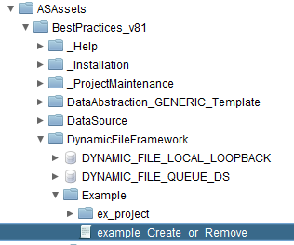
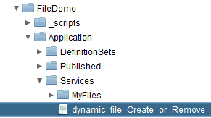
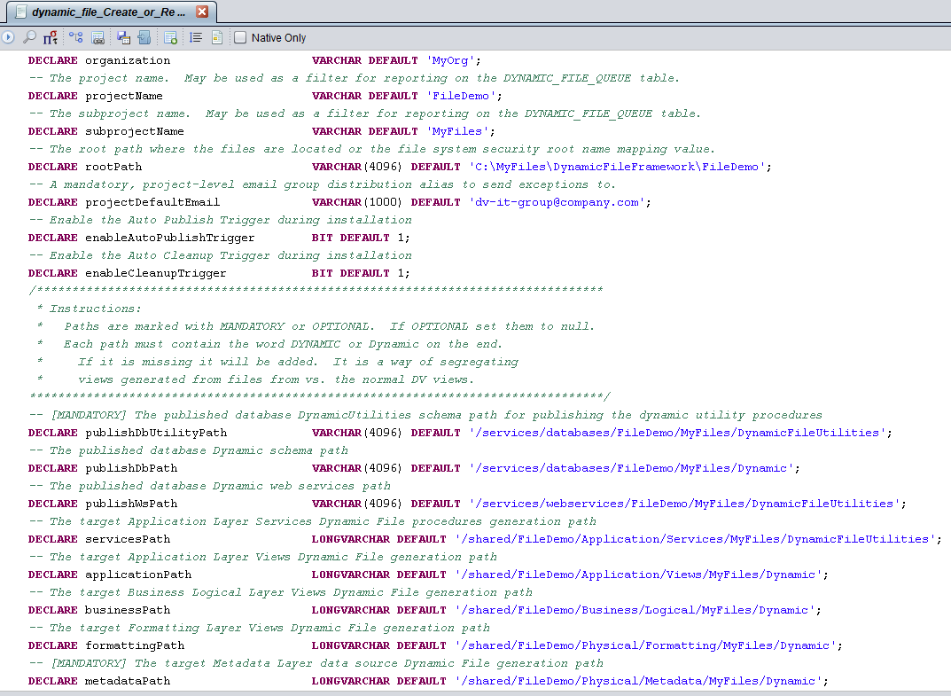
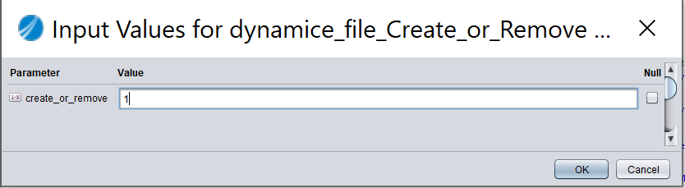
Dynamic File Walk-Through [Setup]
Automatically generate the Dynamic File folders/resources
Requirement – file system directory must exist to start
Copy “example_Create_or_Remove”
Modify variables for paths and email.
Generate project folders and resources

Slide 16
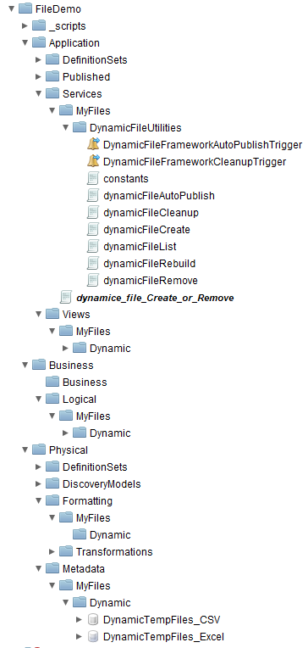
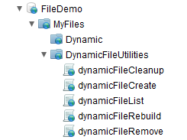
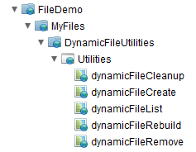
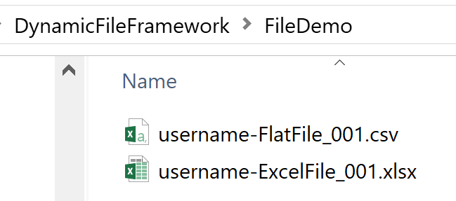
Dynamic File Walk-Through [Generate]
Generated folders
Shared folder layers
Published database
Published web services
File System files
Project API
Project JDBC API
Application Views
Business Views
Project Web Service API
Formatting Views
Metadata Data Sources

Slide 17
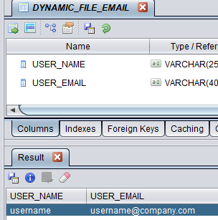
Dynamic File Walk-Through [Configure]
Add users with emails to the lookup table using
/shared/ASAssets/BestPractices_v81/DynamicFileFramework/Helper/emailAddUser
/shared/ASAssets/BestPractices_v81/DynamicFileFramework/Helper/emailAddUserList
Table: DYNAMIC_FILE_EMAIL

Slide 18
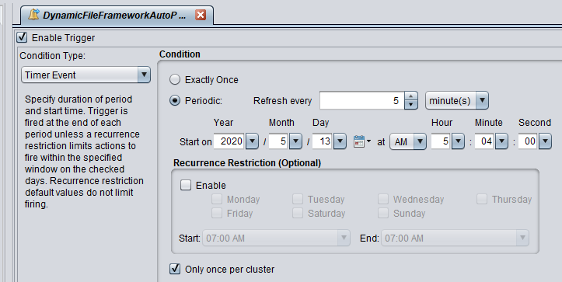
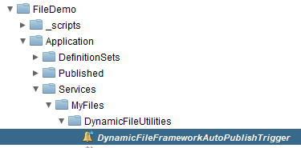
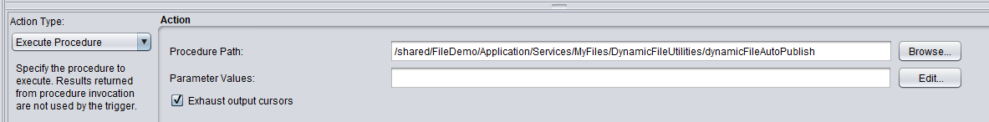
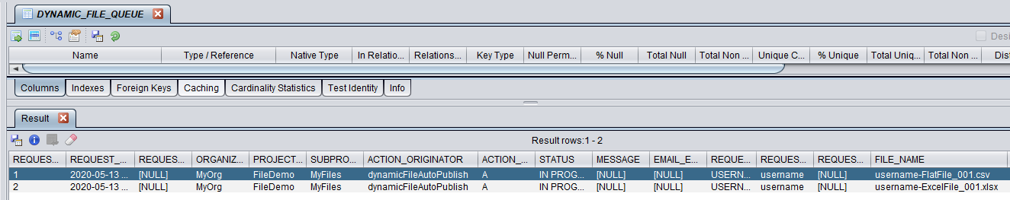
Dynamic File Walk-Through [Auto-Publish]
Auto-Publish Trigger
Insert rows in queue table
#of files and timestamp
Origination of the action
Name of the files

Slide 19
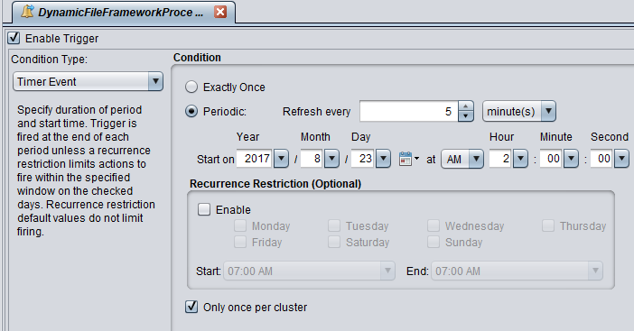
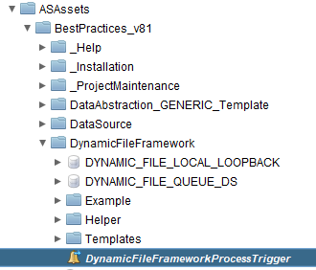
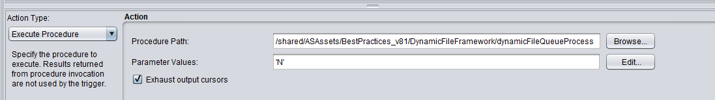
Dynamic File Walk-Through [Execute Action]
Central Trigger executes all actions server-wide
Reads DYNAMIC_FILE_QUEUE table
Introspects files into CSV and Excel data source
Generates views and publishes
Sends email notification

Slide 20
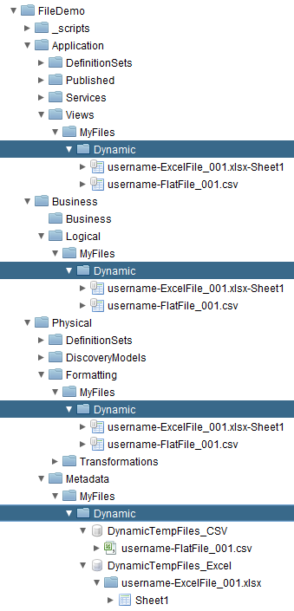
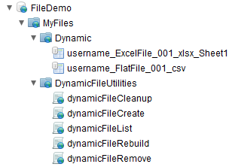
Dynamic File Walk-Through [Generated Views]
TDV views ready to be consumed
File Share
DV Shared
DV Published
Landing Zone described at the subject area level.
Data Source (pre-created) which imports all objects from #1.
Formatting Folder that contains all objects from the file Share Folder.
Business Layer folder that contains a view of all objects in the Dynamic Formatting folder.
Application Layer Views folder.
Published area schema. Views are ODATA compliant [no special characters]
6
5
1
4
3
2

Slide 21
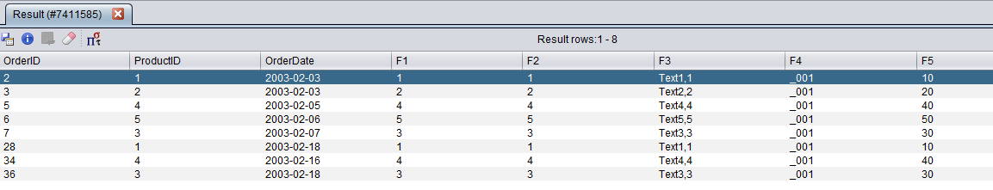
Dynamic File Walk-Through [Query]
TDV views ready to be consumed
Optimize query by putting file first and setting optimizer hints
File always occurs
first in the query
SELECT O.OrderID, O.ProductID, O.OrderDate, F1,F2,F3,F4,F5
FROM Dynamic.username_FlatFile_001_csv F
INNER {OPTION SEMIJOIN="TRUE", LEFT_CARDINALITY="3000", RIGHT_CARDINALITY="10000"} JOIN
Orders.ViewOrder O
ON CAST(F.F1 AS INTEGER) = O.ProductID
Hint goes between
INNER and JOIN
keywords

Slide 22
Feature 3: Privilege Framework

Slide 23
Privilege Framework
Framework for applying privileges on folders in Published Databases, Published Web Services and Shared areas.
Uses a spreadsheet or database table
Can be invoked at deployment time to apply privileges
Framework for creating LDAP or DV “composite” domain groups
Framework for creating DV “composite” domain users

Slide 24
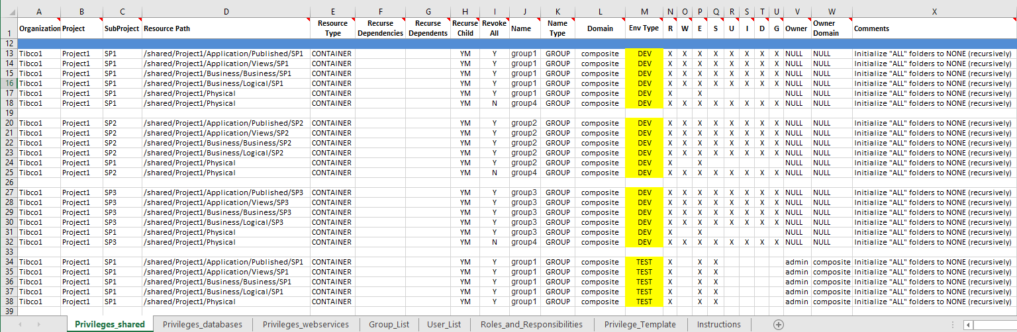
Privilege Spreadsheet “shared”
Privilege Spreadsheet “Privileges_shared”
Note: Revoke All – Only first path in a grouping of same paths should be set to Y and the other paths should be N.

Slide 25
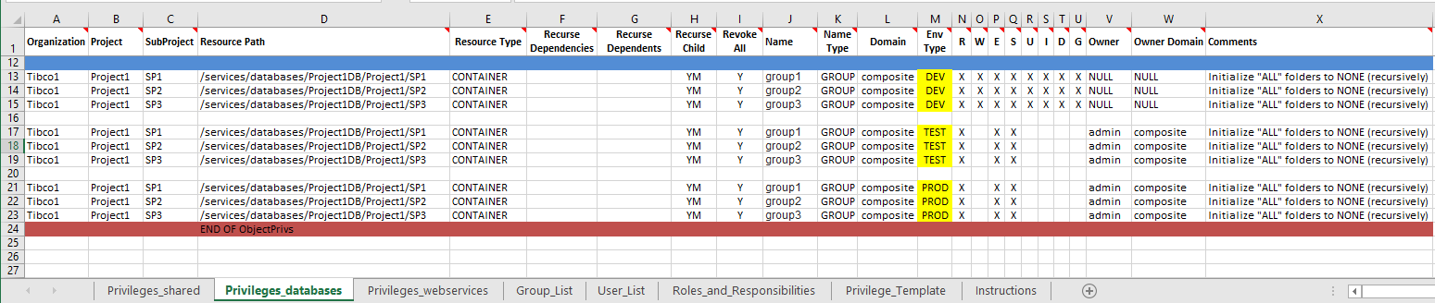
Privilege Spreadsheet “databases”
Privilege Spreadsheet “Privileges_databases”

Slide 26
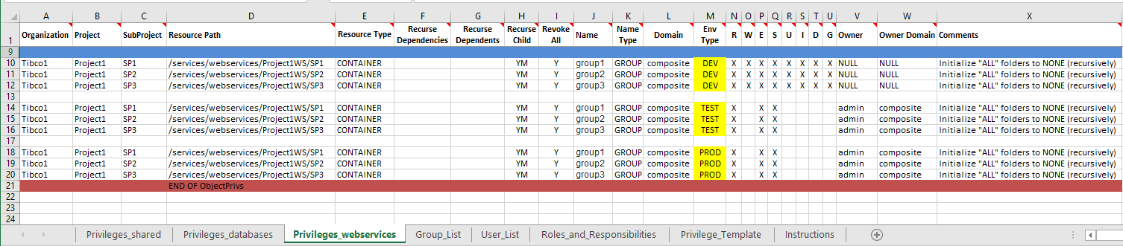
Privilege Spreadsheet “webservices”
Privilege Spreadsheet “Privileges_webservices”

Slide 27
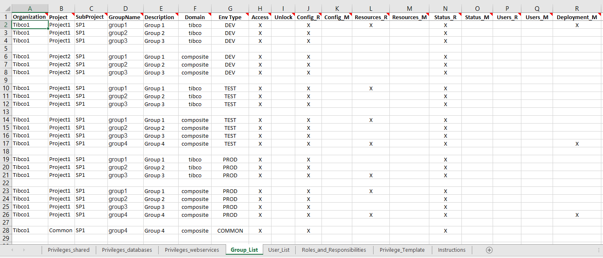
Privilege Spreadsheet “Group_List”
Privilege Spreadsheet “Group_List”

Slide 28
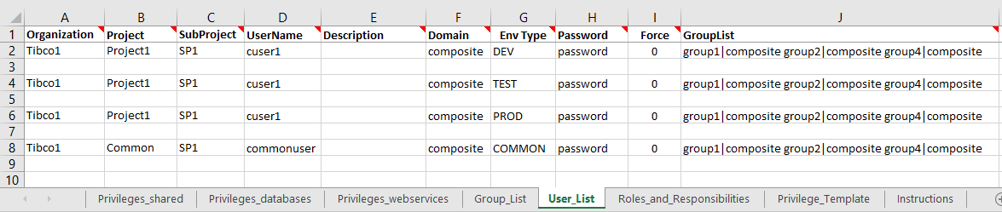
Privilege Spreadsheet “User_List”
Privilege Spreadsheet “User_List”

Slide 29
Privilege Framework APIs
Privileges
getPrivileges – retrieve spreadsheet privileges based on filter criteria.
getPrivilegesFormatted – retrieve actual TDV privileges based on filter criteria.
updatePrivilegesDriver – update privileges based on filter criteria.
validatePrivilegesDriver – validate privileges based on filter criteria.
Groups
getGroups – retrieve groups based on filter criteria.
deleteGroupsDriver – delete groups based on filter criteria.
updateGroupsDriver – update groups based on filter criteria.
validateGroupsDriver – validate privileges based on filter criteria.
Users
getUsers – retrieve users based on filter criteria.
deleteUsersDriver – delete users based on filter criteria.
updateUsersDriver – update users based on filter criteria.
validateUsersDriver – validate users based on filter criteria.

Slide 30
Feature 3: Annotations Framework

Slide 31
Manage Annotations Framework
Framework for managing annotations on published resources.
Objective is to provide annotations for Business Directory resources.
This will provide better insight for business people.
Update resource and column annotations.

Slide 32
Manage Annotations Round-Trip
Round-trip annotation management
The two API’s are meant to provide a way to create a round-trip between DV → People → DV
Step 1 – Generate the resources and columns into a CSV file
Step 2 – People who manage metadata modify the Excel file.
Convert CSV to Excel
Metadata team updates table and column annotations in spreadsheet
Step 3 – Update annotations from the Excel spreadsheet back into DV.
Step 4 – Business Directory consumes annotation resources and columns.

Slide 33
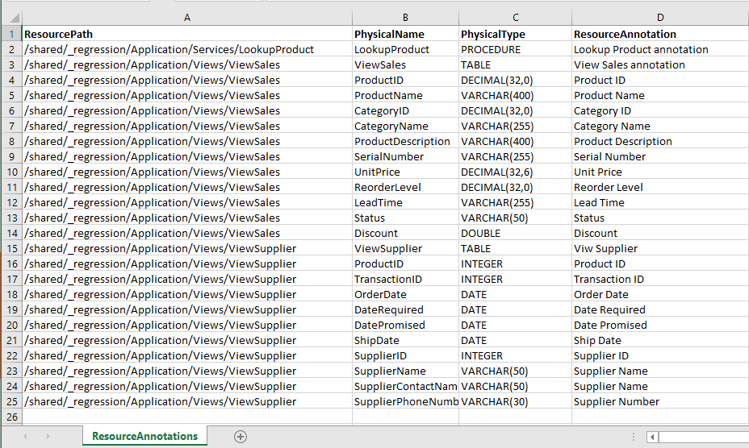
Annotation Spreadsheet
Annotation Spreadsheet example

Slide 34
Manage Annotations Framework APIs
Annotations
generateResourceListToCSV – generate the table and column annotations to a CSV file on the DV server.
updateAnnotations – update the resource and column annotations at the level directly below the published data source layer in DV.
Business Directory will consume the published views along with the table and column annotations.
This will provide better insight for business people.

